Slide 1
Key features of Streaming Data Frameworks
Pravin Y Pawar

Slide 2
Key features of Streaming Data Frameworks
Look for following when determining the framework
Message Delivery Semantics
State Management
Fault Tolerance

Slide 3
Message Delivery Semantics
Types
At most once
Message may get lost, never processed second time
Simplest delivery mechanism
Message may be lost or streaming processor fails to process message
At least once
Never losses message, may be processed many times
Increased complexity as needs to keep track which is the message last processed
If message is not processed, sent back for processing
Every time same message is received, same output should be produced
Exactly once
Message never lost and processed only once
Needs to keep track of messages processed and remove duplicates
Responds with a success or failure after message is produced

Slide 4
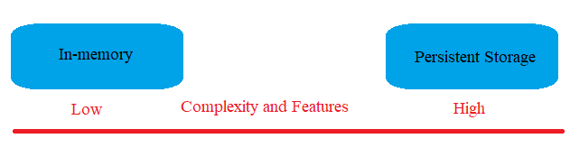
State Management
Where to maintain state?
In memory
For example, sum(sales) for last one hour
Data will be flushed out once one hour window expires
Potential of losing all the data if the stream processor node fails
Persistent storage
For example, needs to join data from two different streams and data being produced at different rate

Slide 5
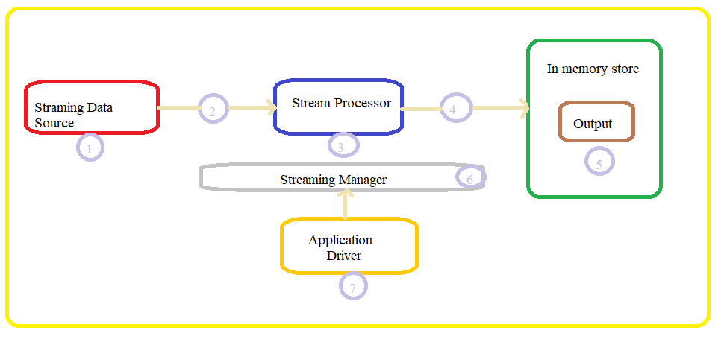
Fault Tolerance
Point of failures in Stream Processing data flow
Incoming stream data
Network carrying data
Stream Processor
Connection to output sink
Output destination
Streaming Manager
Application Driver

Slide 6
Fault Tolerance(2)
Data loss
Data loss over network, job crashes etc.
Replication and Coordination
replicate the state of computation on multiple nodes
In case of failures, streaming manager interacts with replicas
Can predefine number of simultaneous failures
K- fault tolerant where k is number of simultaneous failures
State machine approach
Streaming job is replicated on multiple nodes
Replicas are coordinated by sending same input in same order to all
Allows for quick failover , resulting into little disruption
Rollback recovery approach
Stream processor periodically packages the state of computation into checkpoint
Copies checkpoint to different nodes
In case of failure, stream manager fetches the computation from last saved checkpoint and reschedules it

Slide 7
Thank You!
In our next session: Apache Flink

